Slide 1
Test-Driven Development.
Jude Khalil – 1123092

Slide 2
Points to discuss:
Definition
Advantages
01
05
Disadvantages
02
06
Benefits
How it works
03
Tools
07
Usage in SE
04
08
Conclusion

Slide 3
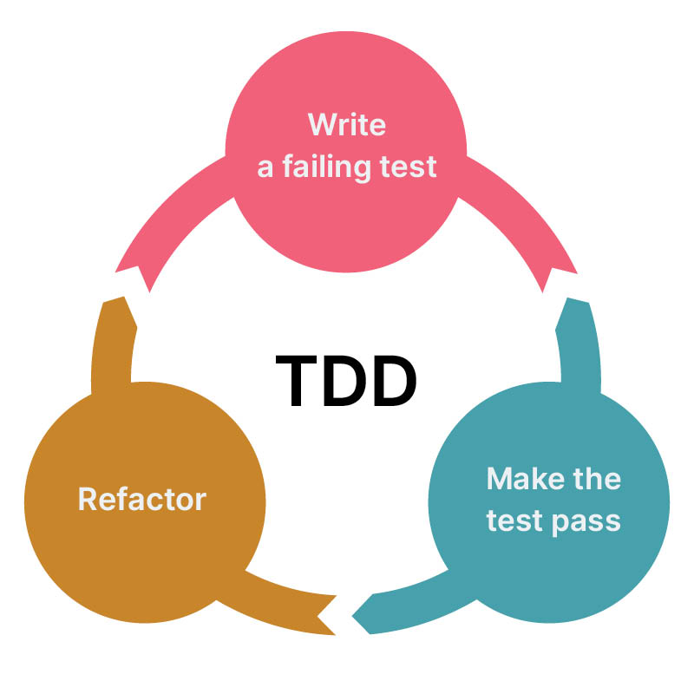
Definition
01
Test-Driven Development is also known as TDD.
TDD is a software development practice where you write tests before writing the actual code.

Slide 4
Benefits of TDD:
Better Collaboration:
Improved Code Quality:
Faster Debugging and Maintenance
By writing tests first, developers create cleaner, more modular code, leading to fewer defects and better maintainability.
Tests serve as documentation for developers, testers, and stakeholders.
Easier identification of bugs and quicker fixes.

Slide 5
Furthermore:
Easier Refactoring:
Improved Project Estimation & Risk Management:
Confidence in making changes with a safety net of tests.
Small, testable increments make it easier to estimate time and manage risks.

Slide 6
Tools:
Unit Testing Frameworks: JUnit (Java), NUnit (.NET), pytest (Python), etc.
Continuous Integration Tools: Jenkins, Travis CI, CircleCI.
Mocking Libraries: Mockito, Moq, etc.

Slide 7
Advantages of TDD:
Write tests before code to ensure better, faster, and more reliable development.
Catch mistakes early, reducing time spent fixing issues later.
Confidence in functionality with a full suite of tests verifying correct behavior.
Easier future changes since tests prevent unintended breakages.
Continuous testing speeds up debugging, helping to identify and fix bugs faster.

Slide 8
Time-consuming – Writing tests before coding can slow down development progress.
Difficult for complex tasks – Testing large or complicated features requires significant effort.
Rigid structure – Making quick changes or adding new features can be challenging.
Balance issue – Too much focus on testing might reduce actual development time.
Requires test automation knowledge – Not ideal for those unfamiliar with automation.
Disadvantages:

Slide 9
TDD process:
1-Write a Test:
4-Run Tests
Again:
Start with a test based on
a requirement.
Ensure all tests pass.
Outline
Steps:
2-Run the
Test:
5-Refactor:
Verify the test fails (as no code exists yet).
Write the simplest code to make the test pass.
Clean up the code without changing functionality.
3-Write Code:

Slide 10
TDD cycle :
Write a minimum code to pass the test.
Green
Red
Refactor
Write a failing test.
Clean up the code while ensuring the test still passes.

Slide 11
Best practice for TDD :
Write small and focused tests.
Keep tests independent and isolated.
Refactor frequently and make sure tests stay clean.
Aim for high test coverage, but don’t overdo it.

Slide 12
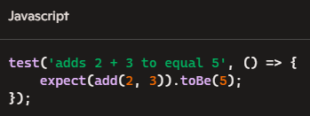
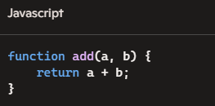
TDD in practice :
Here we have a JavaScript example :
1- Red: (failing test) 2-Green: ( write any code to pass)
3- Refactor: Proceed with your code and keep an eye on the errors and bugs.

Slide 13
Real-life examples:
Project: User Authentication System: Login registration
1- Red:
console.log(login("user@example.com", "password123"));
2- Green :
function login(email, password) { if (email === "user@example.com" && password === "password123") { return "Login successful"; } return "Invalid credentials";}
3- Refactor :
const usersDB = { "user@example.com": "password123" };
function login(email, password) { if (usersDB.hasOwnProperty(email)) { if (usersDB[email] === password) { return "Login successful"; } else { return "Invalid password"; } } return "Invalid email";}
console.log(login("user@example.com", "password123"));
console.log(login("user@example.com", "wrongpass"));
console.log(login("wrong@example.com", "password123"));

Slide 14
TDD vs. other testing methods:
Testing method | Approach | When Tests Are Written | Purpose | Example
TDD | Write tests before writing code | Before development starts | Ensures code meets requirements early | Writing a function to validate input, then coding it to pass the test
Unit testing | Tests individual components separately | After coding | Validates small parts of the application | Testing a login function

Slide 15

Time Investment: Initial slow-down due to writing tests first. Test Maintenance: Ensuring tests stay up to date as code evolves. Balancing TDD with Other Practices: Using TDD in Agile, CI/CD, etc.
TDD challenges:

Slide 16
Common misconsumption:
TDD Slows Down Development: It’s an initial investment but speeds up development long-term.
TDD is Only for Unit Tests: TDD can be used for integration and acceptance tests too.
You Need to Write Tests for Everything: Focus on critical code paths, not every line of code.

Slide 17

TDD in software engineering:
Ensures Code Reliability – Tests are written first to prevent defects early.
Improves Code Maintainability – Facilitates safe refactoring without breaking functionality.
Accelerates Debugging – Issues are identified before major development progresses.
Supports Agile Development – Works well with iterative software building and continuous feedback.

Slide 18
Conclusion:
Test-Driven Development (TDD) is a powerful approach that ensures code reliability, maintainability, and efficiency by writing tests before implementing functionality. By following the Red-Green-Refactor cycle, developers can catch issues early

Slide 19
Resources
Benefits : https://www.conformiq.com/resources/blog-the-six-benefits-of-test-driven-development-05-16-2023
Cycle : https://developer.ibm.com/articles/5-steps-of-test-driven-development/
Tools : https://www.browserstack.com/guide/what-is-test-driven-development
Advantages / disadvantages : https://testsigma.com/blog/test-driven-development-testsigma/

